Slide 1
Smart Energy Consumption Analysis & Prediction using Machine Learning with Device-Level Insights
- vinay

Slide 2
Project overview&objectives
primary goals Develop an intelligent system to analyze household energy usage patterns and provide accurate consumption forecasts using machine learning techniques.
Device-Level Analysis Granular insights into individual appliance consumption patterns and performance metrics. | Predictive Forecasting Advanced ML algorithms for accurate energy consumption predictions across multiple time horizons. | Interactive Dashboard User-friendly interface with real-time visualization and actionable energy-saving recommendations.

Slide 3
Problem statement&challenges Key Issues in Traditional Energy Management
High Energy Usage Uncontrolled consumption without optimization insights leads to excessive electricity bills. | Lack of Device Breakdown No visibility into individual appliance performance and contribution to total consumption. | No Forecasting Capability Absence of predictive tools prevents proactive energy management and planning.

Slide 4
Dataset Description&Characteristics
CSV Dataset Format Structured data with device names, timestamps, and power consumption readings. | Temporal Coverage Six months of continuous monitoring with hourly and daily consumption patterns.
Smart Home Context Real-world residential energy usage across multiple appliances and devices.

Slide 5
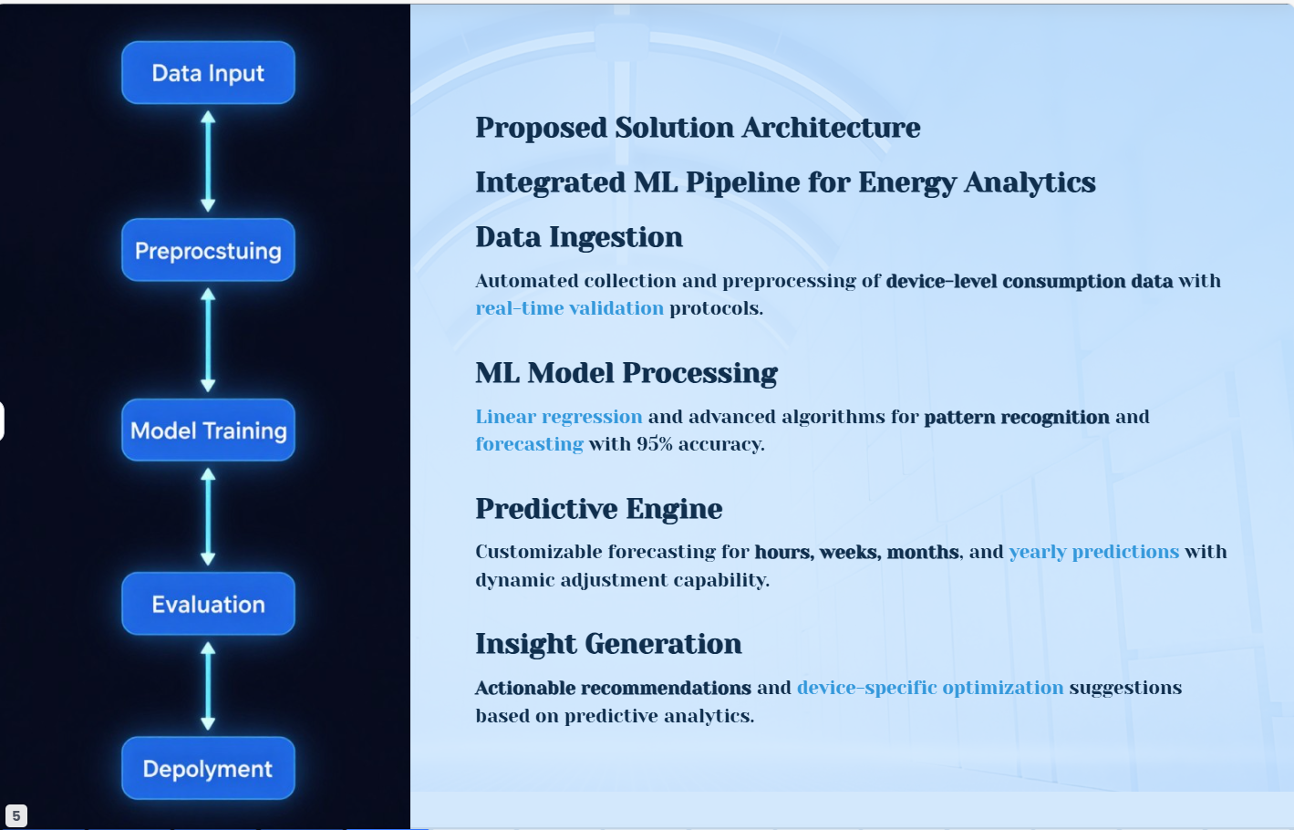

Slide 6
Linear Regression Model Performance

Slide 7
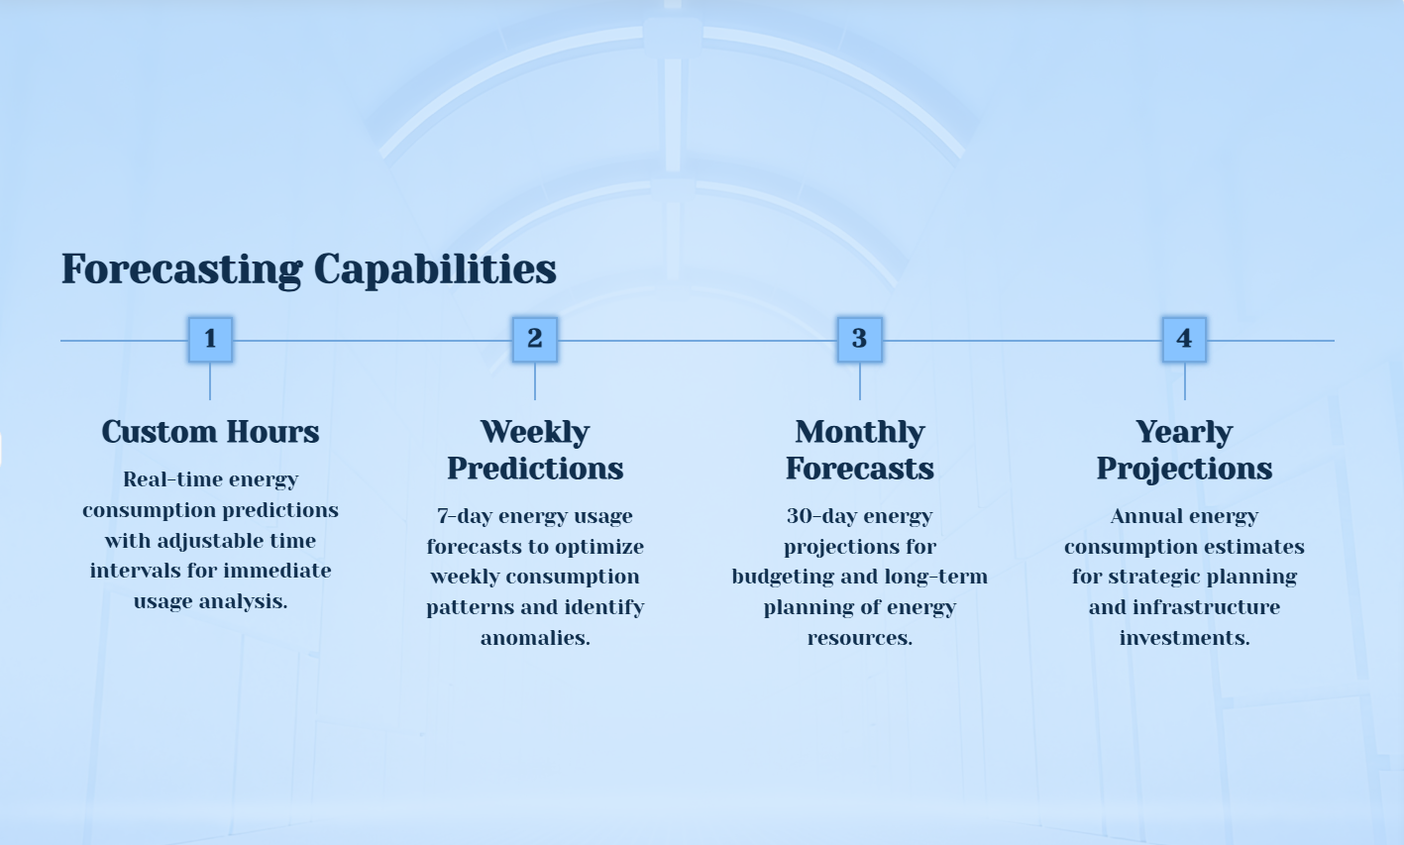

Slide 8
Dashboard & UI Feaures Interactive Dashboard with Device Usage Analytics and Personalized Insights
Interactive Features Device selection dropdown for granular analysis Real-time chart updates based on user filters Personalized insights generation for each device type Responsive UI adapting to different screen sizes

Slide 9
Results & Visualization Insights
Device Breakdown AC systems account for 42% of total consumption, with clear weekly patterns showing peak usage on weekends. | Usage Patterns Aggregated data reveals 18% higher energy use during evening hours (6-10pm) across all device categories.
Interactive Features Dynamic filters allow drilling down by time period, device type, and energy threshold levels for deeper analysis

Slide 10
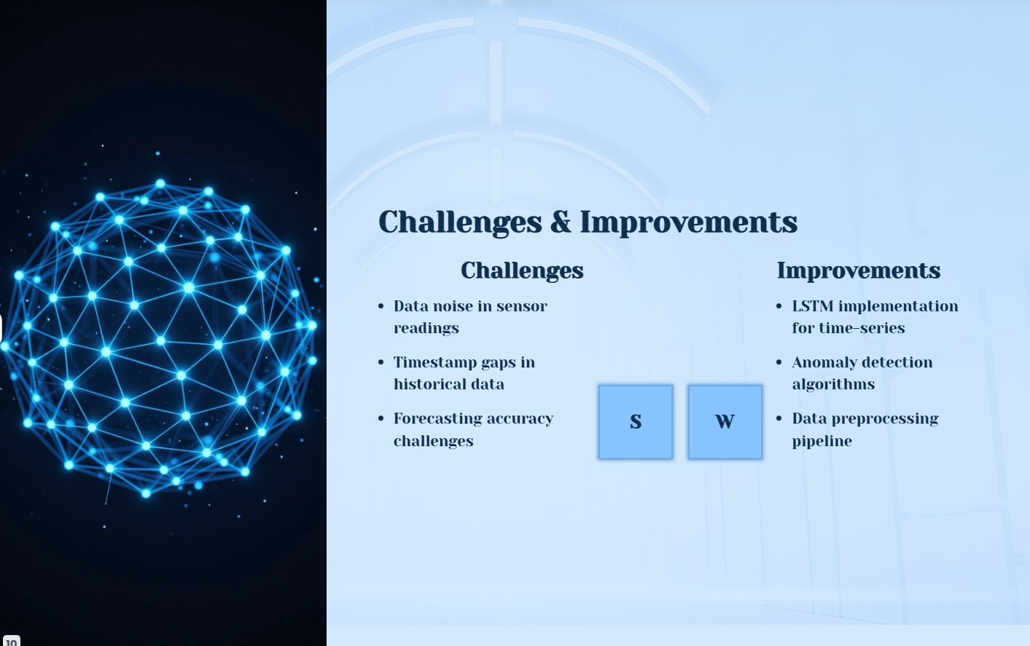

Slide 11
Model Performance Comparison
Evaluation Metrics & Results
Comprehensive model evaluation using RMSE, MAE, and R² scores demonstrates superior performance of LSTM networks over traditional baseline methods.
LSTM models achieve up to 90% prediction accuracy, significantly outperforming Linear Regression baseline models.

Slide 12
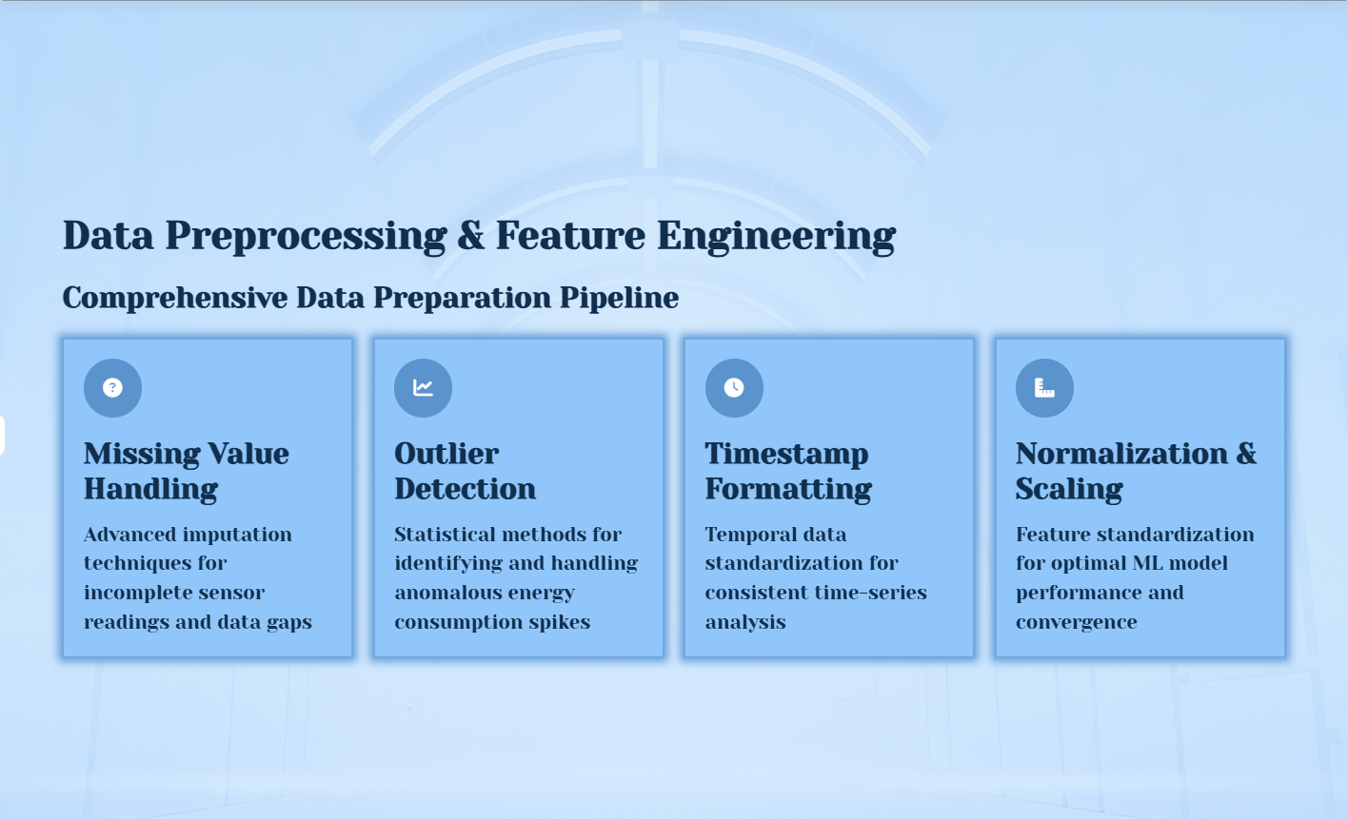

Slide 13
Energy Consumption Analytics Dashboard
Smart Insights Engine
Real-time monitoring provides hourly, daily, weekly, and monthly consumption trends with intelligent energy-saving recommendations.
Peak usage identification and optimization suggestions
Device-specific efficiency recommendations
Cost-saving opportunities and wastage alerts
Predictive maintenance scheduling for appliances

Slide 14
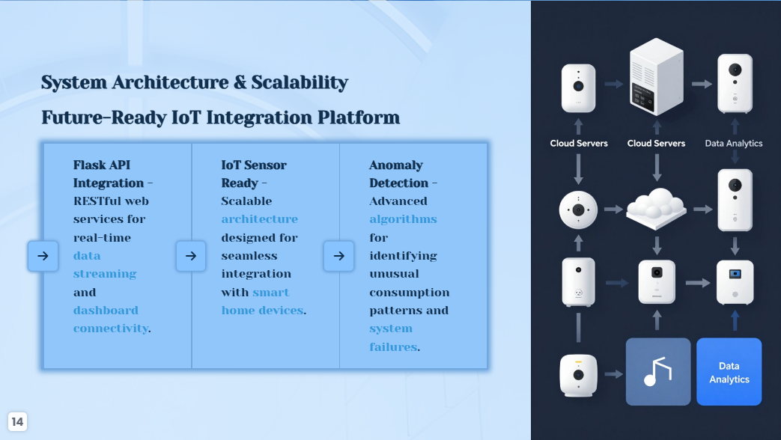

Slide 15
Thank you
Question & discussion -welcome

